Slide 1
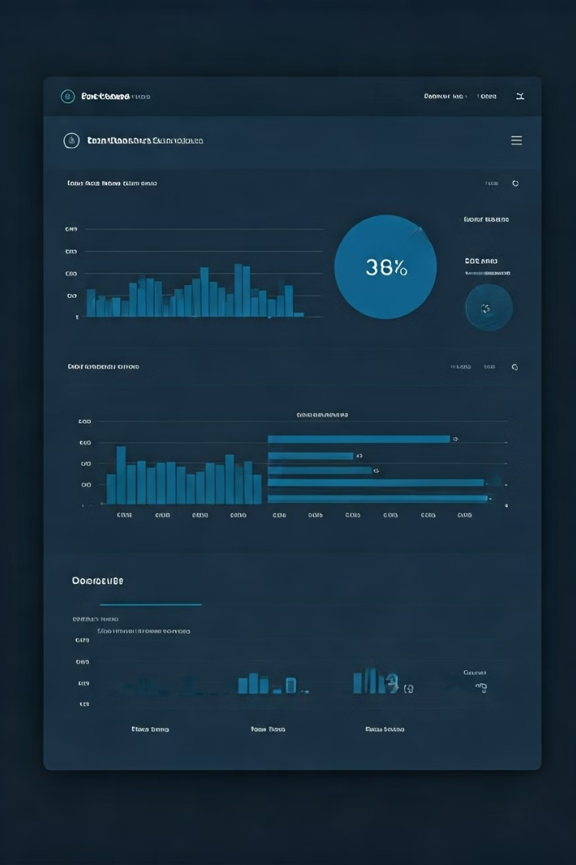
Amazon Sales Dashboard Using Power BI
This presentation showcases a data analytics project developed by Gurinder Singh, Aanchal, Gunisha, Vaibhav, and Rupali from Chandigarh University in October 2024. The project focuses on creating a Power BI dashboard for real-time tracking of Amazon sales and courier status.

Slide 2

Project Overview
1
Real-time Tracking
The project addresses the need for real-time tracking of Amazon sales and courier status.
2
Power BI Dashboard
A Power BI dashboard was developed to visualize key sales and logistics data.
3
Key Features
The dashboard features sales data, courier statuses, and region-specific sales trends.

Slide 3

Problem Definition
Data Volume
Managing large volumes of sales and shipment data was a challenge.
Courier Status
Understanding courier statuses to optimize deliveries was crucial.
Regional Trends
Analyzing sales and product trends across different regions was necessary.

Slide 4
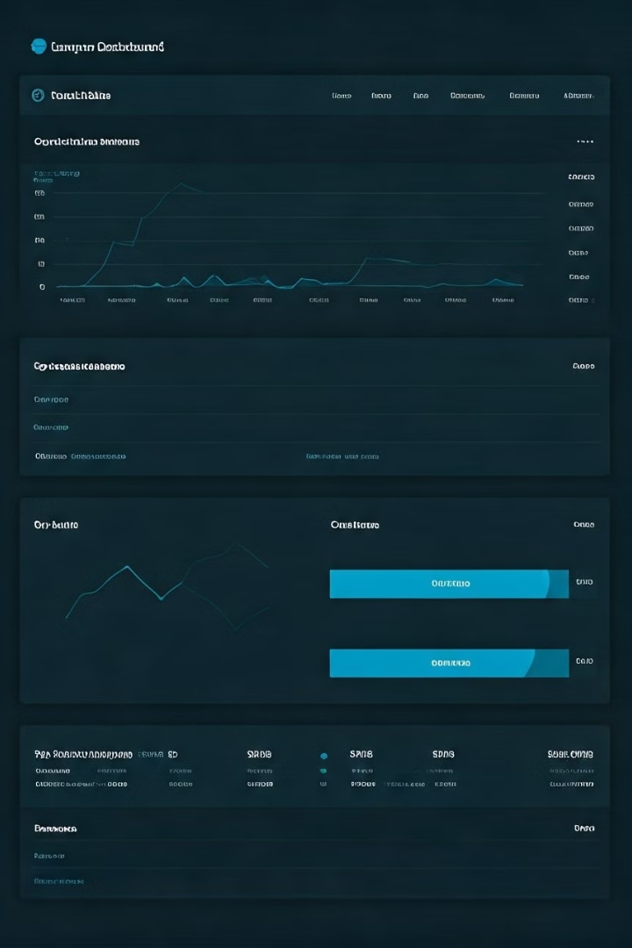
Amazon Dashboard Overview
The Amazon dashboard provides a comprehensive overview of key sales and logistics metrics. It tracks total sales, courier statuses, top-performing product categories, and shipping trends across different regions.

Slide 5
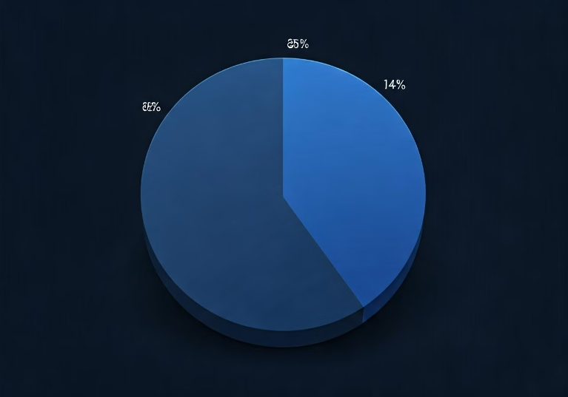
Key Insights
Courier Status
Total Sales
Total sales amounted to 11.58M USD between 30-12-1899 and 30-04-2022.
Most shipments (85.6%) are successfully delivered.

Slide 6

Top Seller Categories
T-shirts lead as the top-selling product category. The bar chart visually represents the top five categories and their relative sales performance.

Slide 7
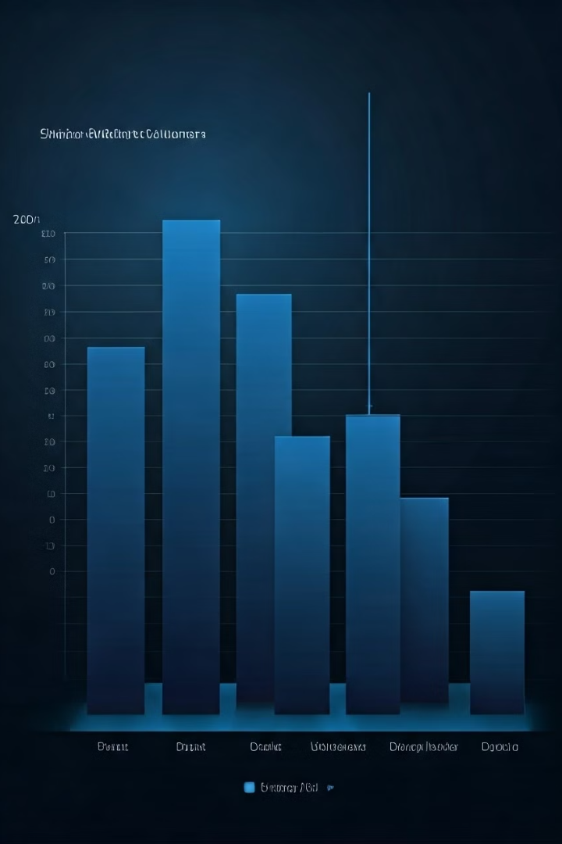
Region-wise Shipment Volume
Telangana and Uttar Pradesh show the highest shipment volumes, as illustrated in the bar chart showing region-wise shipment data.

Slide 8
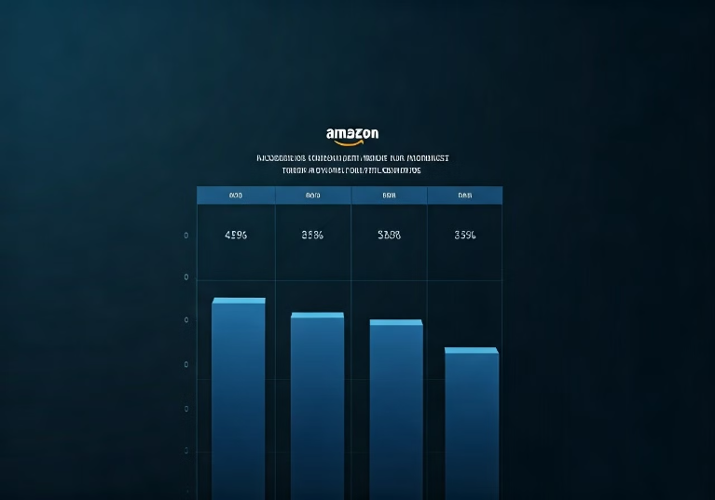
Fulfillment and Delivery Insights
Fulfillment
Delivery Partners
Ecart and Easy Ship are the primary delivery partners.
Amazon's in-house fulfillment outperforms third-party services.

Slide 9

Conclusion
1
Objective Met
The dashboard successfully tracks sales and courier status.
2
Areas for Improvement
Insights highlight areas for enhancing shipping efficiency.

Slide 10

Future Enhancements
Predictive Analytics
Integrating predictive analytics for sales forecasting is planned.
Detailed Analysis
More detailed courier performance analysis will be incorporated.

